Slide 1

Introductory Computer Networking and IT Security
Week 3

Slide 2
Agenda
Introduction to TCP/IP protocols
Each layer datagrams and their encapsulations
Differentiate TCP and UDP
Process/ application layer protocol
Internet layer protocol
IPv4 subnetting
VLSM (variable length subnet mask)

Slide 3
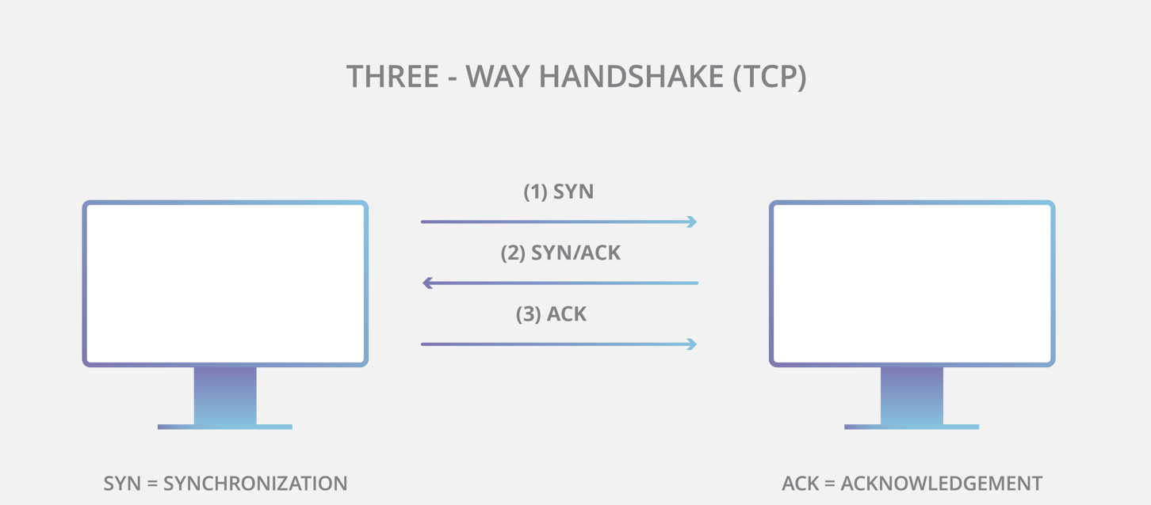
Introduction to TCP/IP protocols
The Internet Protocol (IP) is the address system of the internet and has the core function of delivering packets of information from a source device to a target device and it requires another protocol, typically Transmission Control Protocol (TCP). TCP is used in conjunction with IP in order to maintain a connection between the sender and the target and to ensure packet order. For example, when an email is sent over TCP, a connection is established and a 3-way handshake.

Slide 4
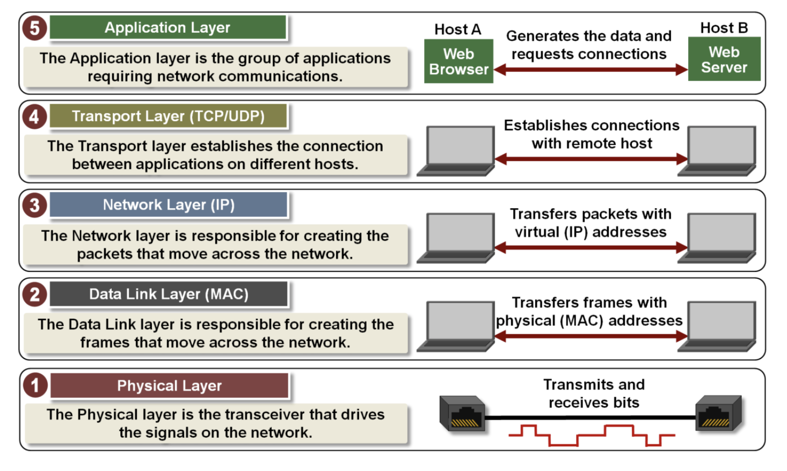
Introduction to TCP/IP protocols

Slide 5
Application Layer
  Provides access to the TCP/IP environment for users and also provides distributed information services.
  The Application layer provides applications the ability to access the services of the other layers and defines the protocols that applications use to exchange data.
  Some application layer protocols are: FTP, SMTP.,TELNET, SSH,DNS

Slide 6
Application Layer Protocols
FTP: The File Transfer Protocol (FTP) is used to send files from one system to another under user command. Both text and binary files are accommodated, and the protocol provides features for controlling user access.
SMTP :The Simple Mail Transfer Protocol (SMTP) provides a basic electronic mail transport facility. It provides a mechanism for transferring messages among separate hosts.
TELNET: provides a remote logon capability in plain texts.

Slide 7
Application Layer Protocols
SSH: Secure Shell (SSH) provides a secure remote logon capability, which enables a user at a terminal or personal computer to log on to a remote computer and function as if directly connected to that computer.
DNS: The Domain Name System (DNS) is a hierarchical decentralized naming system for computers, services, or any resource connected to the Internet or a private network.

Slide 8
Transport Layer
  The main purpose of the transport layer is to shield the upper-layer applications from the complexities of the network.
  Transfer of data between end points. May provide error control, flow control,congestion control, reliable delivery.
  Two main protocols used in this layer are:
    Transmission Control Protocol (TCP)
    User Datagram Protocol (UDP)

Slide 9
Transmission Control Protocol (TCP)
  TCP provides a reliable connection for the transfer of data between applications.
  A connection is simply a temporary logical association between two entities in different systems. A logical connection refers to a given pair of port values.
  For the duration of the connection, each entity keeps track of TCP segments coming and going to the other entity, in order to regulate the flow of segments and to recover from lost or damaged segments.
  Each process with a host must have an address that is unique within the host addresses are known as ports.

Slide 10
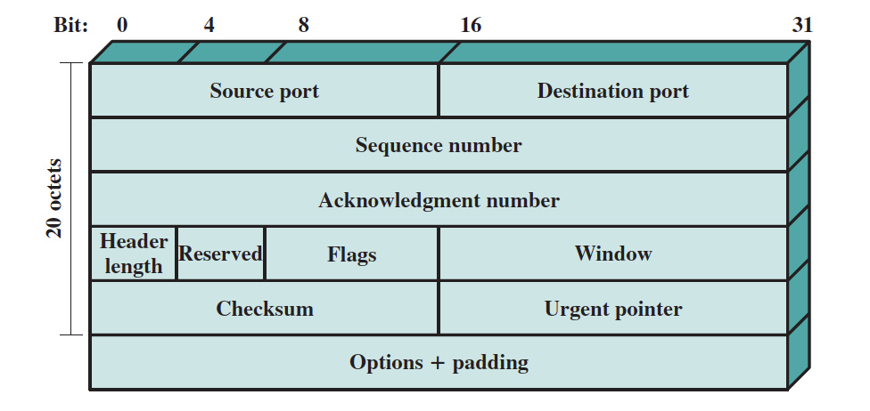
Transmission Control Protocol (TCP)
TCP header

Slide 11
User Datagram Protocol (UDP)
UDP does not guarantee delivery, preservation of sequence, or protection against duplication.
UDP enables a procedure to send messages to other procedures with a minimum of protocol mechanism.
Because it is connection less, UDP has very little to do.
Some transaction-oriented applications make use of UDP; one example is SNMP (Simple Network Management Protocol), the standard network management protocol for TCP/IP networks.

Slide 12
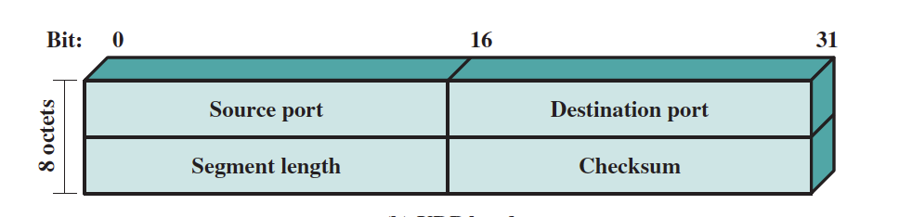
Transport Layer Protocol
UDP header

Slide 13
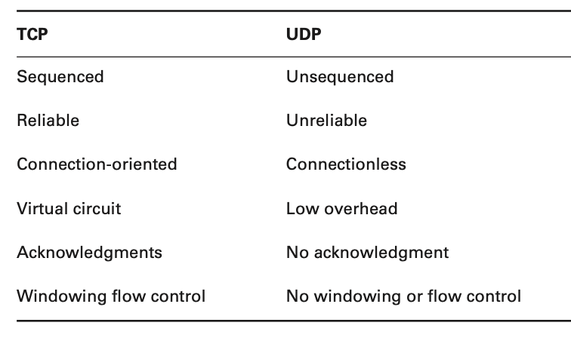
Transport Layer Protocol
TCP vs UDP

Slide 14
Internet Layer
  Shields higher layers from details of physical network configuration.
  Provides routing.
  May provide Quality of Service (QoS), congestion control.
  Some Internet Layer protocoles are IP, ICMP, ARP etc.

Slide 15
Internet Layer Protocol
  Provides addressing of sender and receiver on the internet.
  Protocol defines how to route messages through a network.
  Internet protocol datagrams are not continuous.
  Delivery not guaranteed.
  IP addresses are used to identify source and destinations.

Slide 16
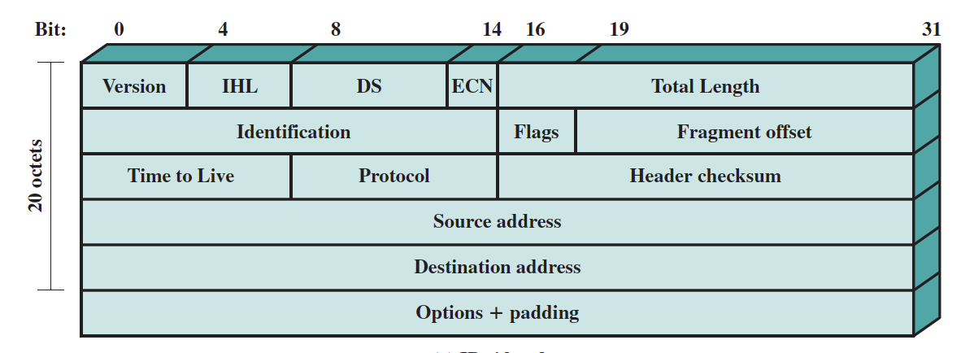
Internet Layer Protocol
Internet Protocol (IP) header

Slide 17
Internet Layer Protocol
Internet Control Message Protocol (ICMP)
  ICMP works at the Network layer and is used by IP for many different services.
  ICMP is a management protocol and messaging service provider for IP.
  Its messages are carried as IP datagrams.

Slide 18
Internet Layer Protocol
Address Resolution Protocol (ARP)
    ARP resolves IP addresses to Ethernet (MAC) addresses.
    When IP has a datagram to send, it must inform Ethernet, of the destination’s hardware address on the local network. If IP doesn’t find the destination host’s hardware address in the ARP cache, it uses ARP to find this information. As ARP interrogates the local network by sending out a broadcast asking the machine with the specified IP address to reply with its hardware address. ARP translates the IP address into a hardware address.

Slide 19
Network access/data link layer
  Logical interface to network hardware.
  May be stream or packet oriented.
  May provide reliable delivery.
  Some data link layer protocols are:
  Ethernet, Wi-Fi, ATM, frame relay

Slide 20
Physical layer
  Transmission of bit stream.
  Specifies medium, signal encoding technique, data rate, bandwidth, and physical connector.
  Some examples are:
  Twisted pair, optical fiber, satellite, terrestrial microwave

Slide 21
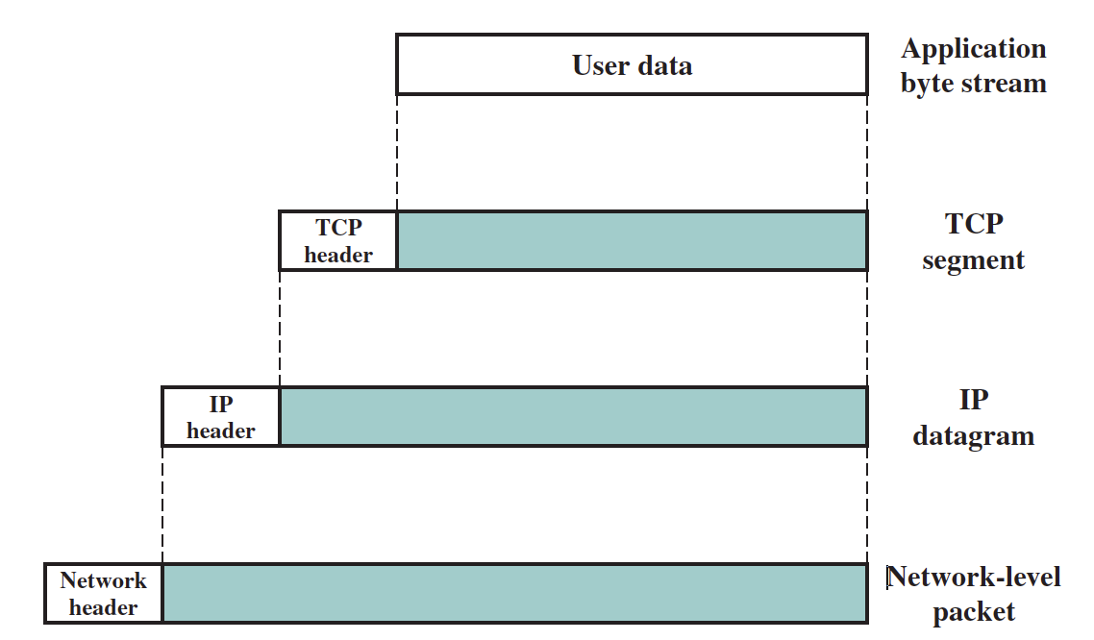
Protocol Data Units (PDUs) in the TCP/IP Architecture

Slide 22
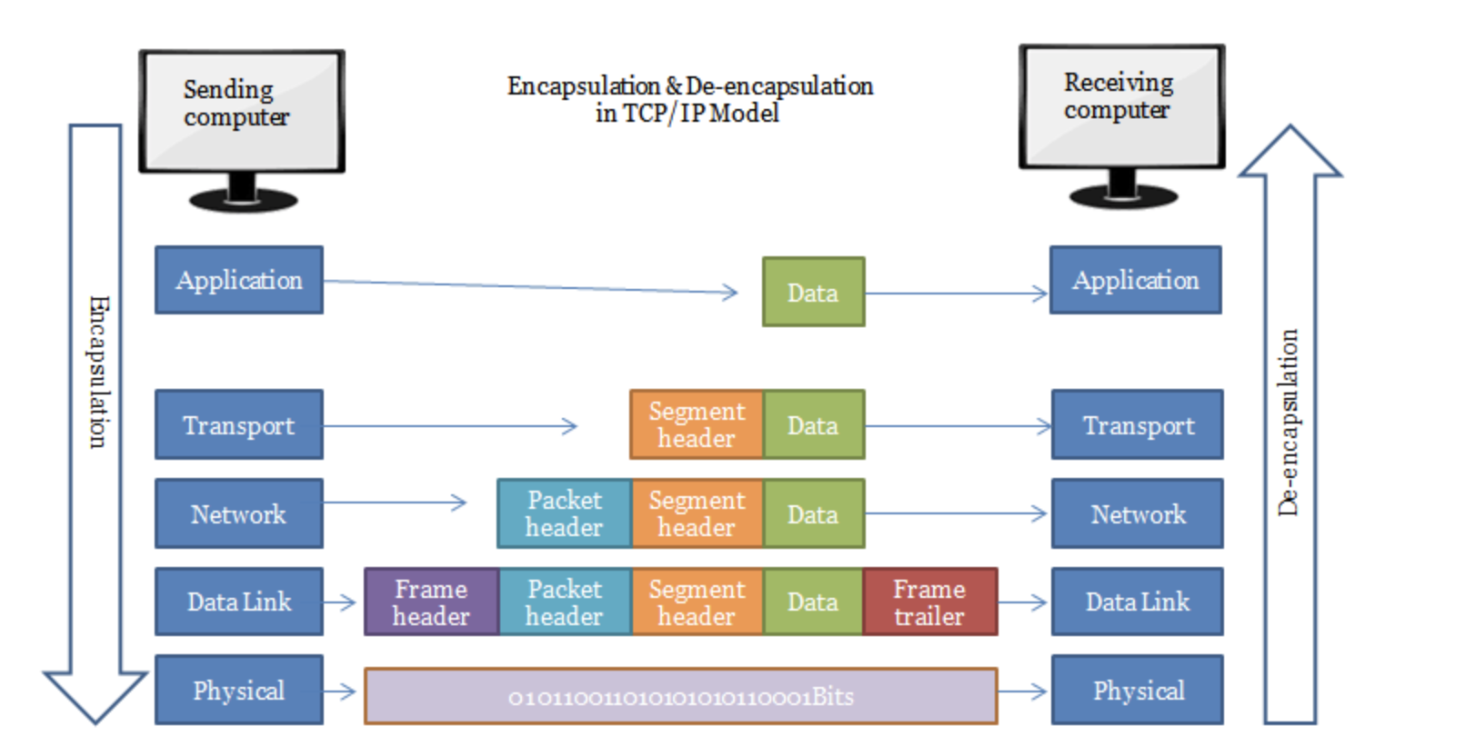
Data Encapsulation in TCP/IP Model

Slide 23
IP V4 SUBNETTING and VLSM (Variable Length Subnet Mask)

Slide 24
IPV4
  In IPv4, an address is a 32 bit quantity that uniquely identifies a network interface.
  In IPv4 there are (2)³² = 4,294,967,296 unique addresses possible.
  IP addressing was designed to allow hosts on one network to communicate with a host on a different network regardless of the type of LANs the hosts are participating in.

Slide 25
  BIT: A bit is one digit, either a 1 or a 0.
  BYTE: A byte is 7 or 8 bits, depending on whether parity is used.
  OCTET: An octet, made up of 8 bits, is just an ordinary 8-bit binary number.
  Network address: This is the designation used in routing to send packets to a remote network—for example, 10.0.0.0, 172.16.0.0, and 192.168.10.0.
  Broadcast address: The address used by applications and hosts to send information to all nodes on a network is called the broadcast address.
  CIDR – (classless inter domain routing) total number of network bits.

Slide 26
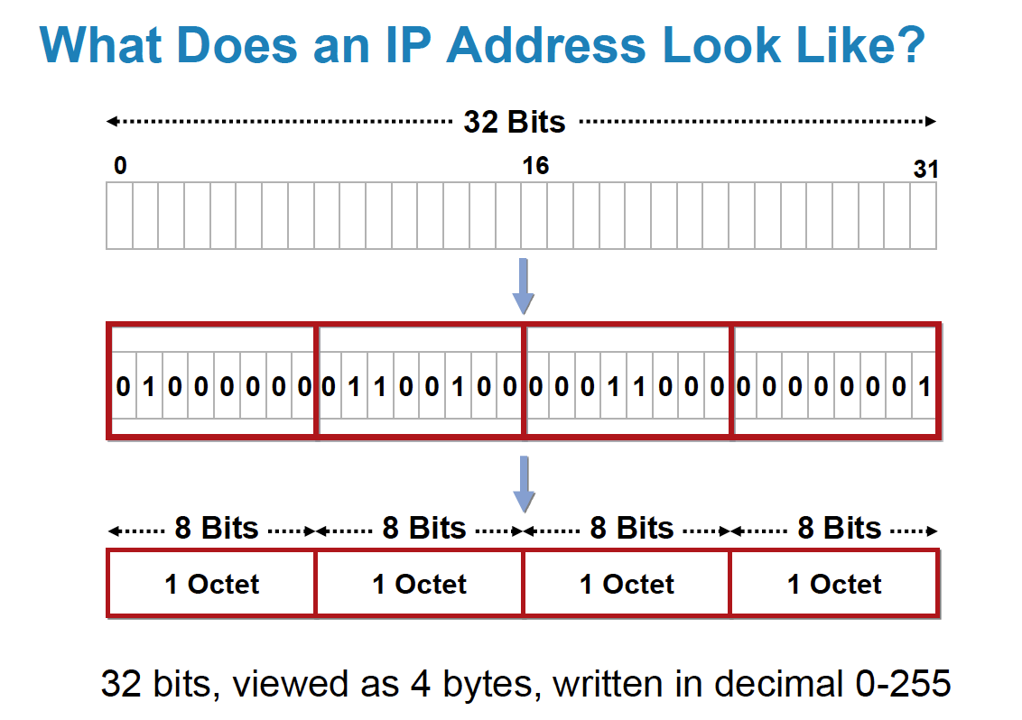
IP Addressing
How does IP address look like ?

Slide 27
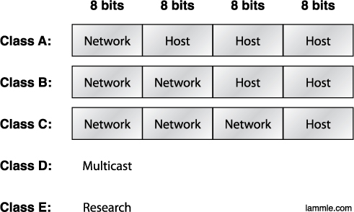
IP Addressing
Subdividing an IP address into a network and node address is determined by the class designation of one’s network. This figure summarizes the three classes of networks

Slide 28
IP class range
Class | 1st Octet Decimal Range | Default Subnet mask
A | 1 – 126 | 255.0.0.0
B | 128 - 191 | 255.255.0.0
C | 192 - 223 | 255.255.255.0
D | 224 - 239 | Reserved for multicasting
E | 240 - 254 | Experimental, used for research

Slide 29
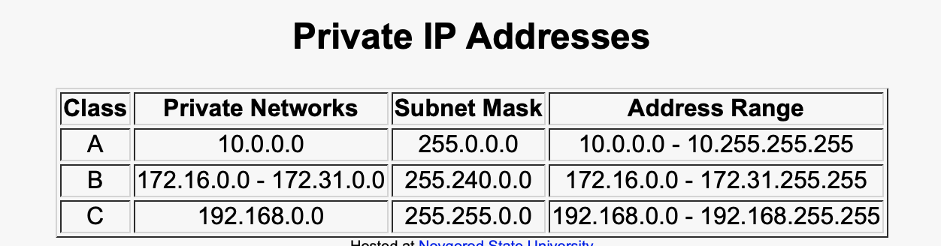
IP Addressing

Slide 30
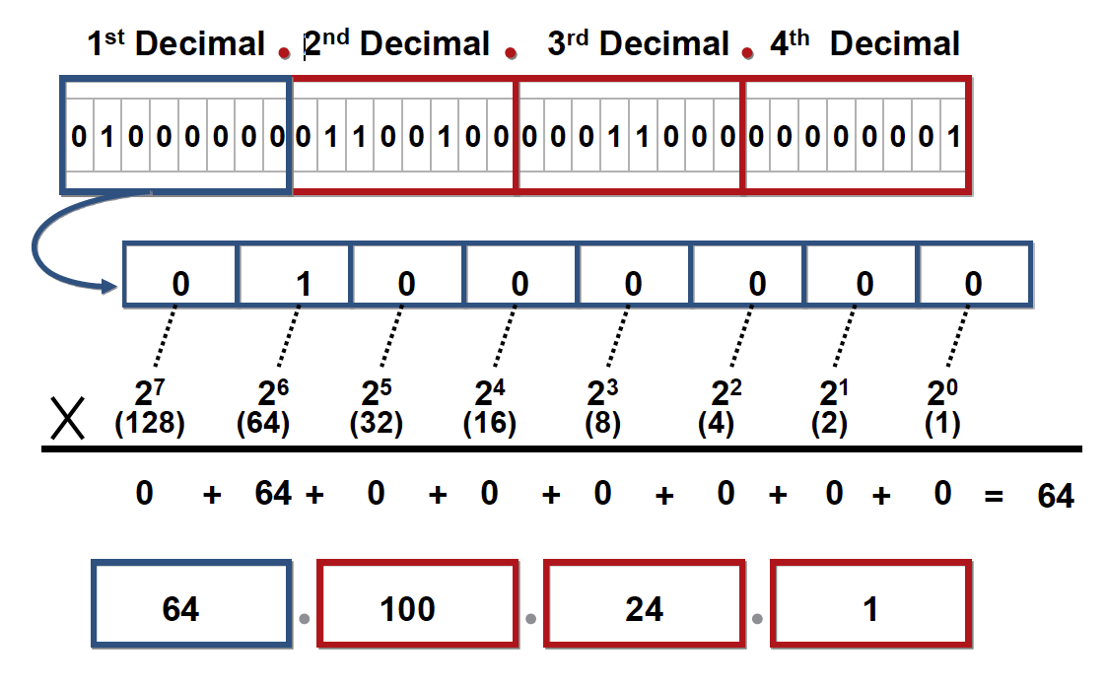
IP Addressing
IP Address Format in Dotted Decimal

Slide 31
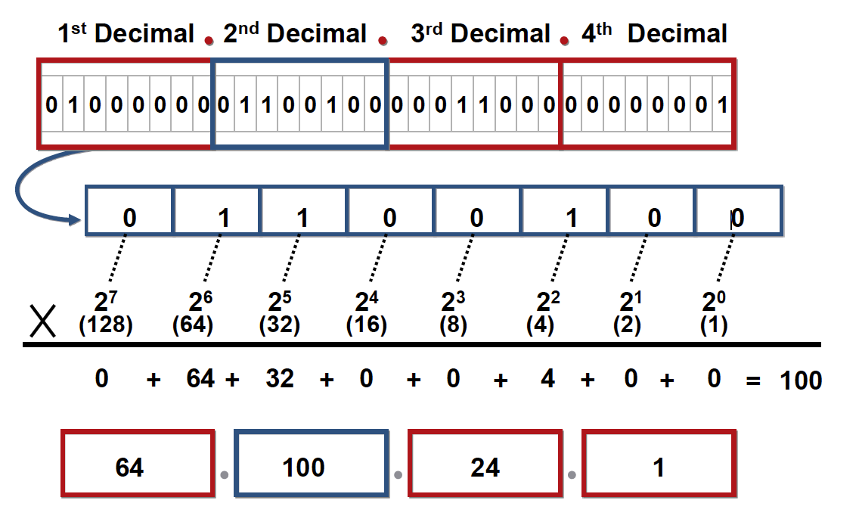
IP Addressing
IP Address Format in Dotted Decimal

Slide 32
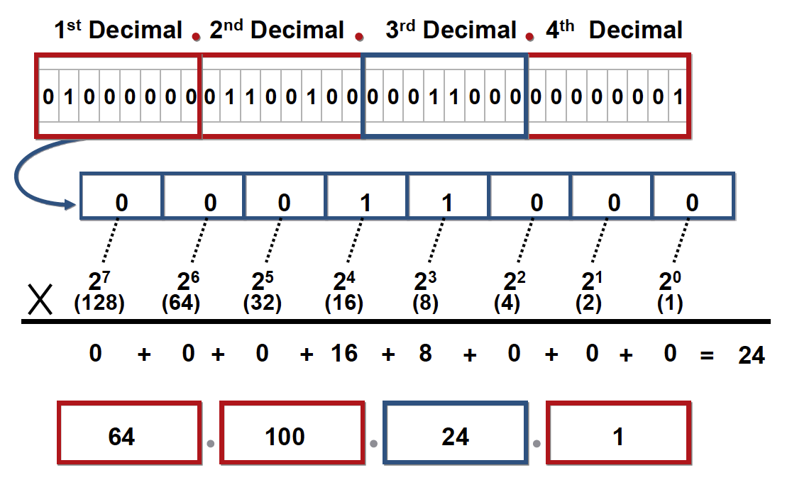
IP Addressing
IP Address Format in Dotted Decimal

Slide 33
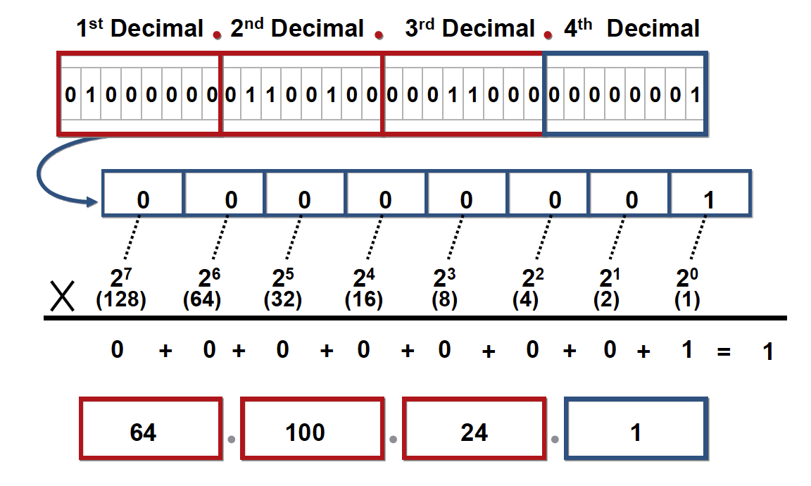
IP Addressing
IP Address Format in Dotted Decimal

Slide 34
4 Questions….
Process of diving a large network into multiple small networks.
What is the Subnet mask?
What is the number of network?
What is the number of hosts?
How many valid host are there?

Slide 35
subnetting
network | 1 | 2 | 4 | 8 | 16 | 32 | 64 | 128 | 256
hosts | 256 | 128 | 64 | 32 | 16 | 8 | 4 | 2 | 1
CIDR | /24 | /25 | /26 | /27 | /28 | /29 | /30 | /31 | /32
Subnet mask | 255.255.255.0 | 255.255.255.128 | 255.255.255. 192 | 255.255.255. 224 | 255.255.255. 240 | 255.255.255. 248 | 255.255.255. 252 | 255.255.255. 254 | 255.255.255. 255

Slide 36
Question:
An administrator have 192.168.1.0/24 network. The suffix /24 (pronounced as "slash 24") tells the number of bits used for network address. In this example, the administrator has three different departments with different number of hosts. Sales department has 100 computers, Purchase department has 50 computers, Accounts has 25 computers and Management has 5 computers. In CIDR, the subnets are of fixed size. Using the same methodology the administrator cannot fulfill all the requirements of the network.

Slide 37


Slide 38
Summary
TCP/IP model and its protocols (Application layer, Transport layer, Network layer, Data Link layer, Physical layer)
Difference between TCP and UDP
Encapsulation in each layer
IP V4 subnetting

Slide 39
THANK YOU

